Slide 1


CUSTOMIZE WITH YOUR GFWC CLUB
[Your Club Name Here]

Slide 2

GUIDELINES
Use (30pt Horizontal and 16pt Vertical) font on your club name. Remove [] when finished.
Capitalize each word. Do not use ALL CAPS unless it is on your official club charter.
If your club name is longer than 30 characters, use two lines.
Using GFWC in front of your name is not necessary in this format.
Keep the color font used on each template.
Be aware that users cannot download transparent background files unless they are Canva Pro users. Free for nonprofits that have their own Tax ID, must register using your club name, not GFWC National.

Slide 3
[Insert Club Name]

Slide 4

[Insert Club Name]

Slide 5

[Insert Club Name]

Slide 6

[Insert Club Name]

Slide 7

[Insert Club Name]

Slide 8

[Insert Club Name]

Slide 9

[Insert Club Name]

Slide 10

[Insert Club Name]

Slide 11
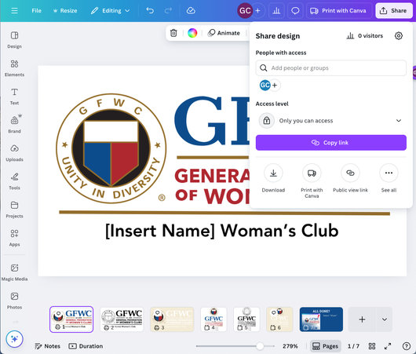
ALL DONE?
When you’ve added your club’s name to all the templates it’s time to export them!
  Select “Share”
  Then “Download”

Slide 12
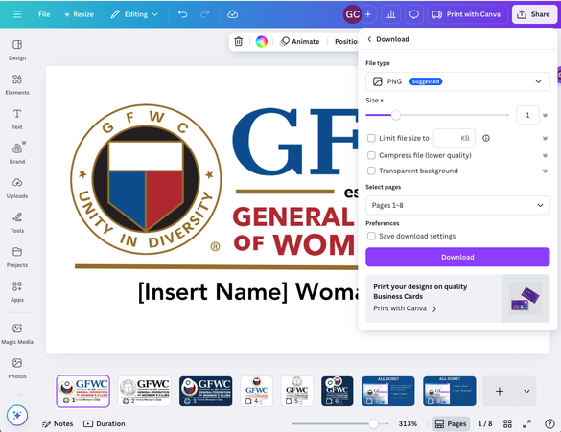
ALL DONE?
  Select PNG under “File Type”
  Select Transparent Background if you are a Canva Pro user. All other files will have a white or color background.
  Select the pages you would like to download and save the files on your computer.

